Slide 1
British Airways Customer Reviews

Slide 2
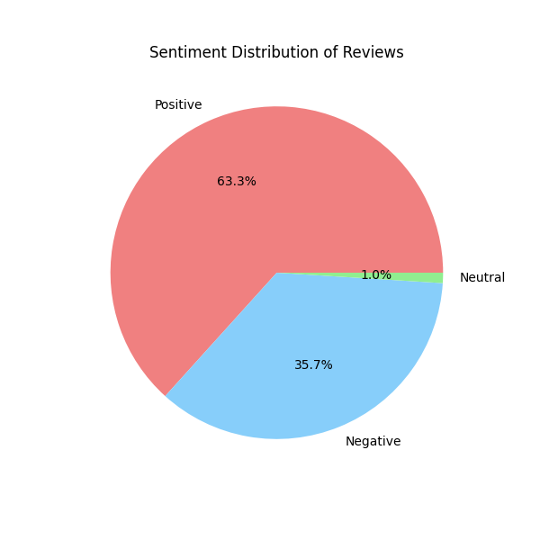
The given pie chart shows that more than 2/3 of the feedbacks are positive

